Slide 1

Design a 4-bit magnitude comparator (A>B, A=B, (A<B) and explain its working and applications.
TEAM MEMBERS
LALITH.N (2620030548)
PRANEETH.T (2620030624)
MONIKAVAISHNAVI.M(2620030544)
Sahithya Reddy (2620030586)
FACULTY NAME= MR.RAHUL
(
\

Slide 2

4-BIT MAGNITUDE COMPARATOR
Inputs
Priority scan
Compare from the most significant bit
A3…A0
B3…B0
MSB → LSB
One result
A>B · A=B · A<B
A comparator reads two binary words, A and B, and decides which one is larger.
Start at the left. The first unequal bit settles the result.
Notes:
Introduce the circuit as a decision maker for two four-bit words. Emphasize that the scan begins with the most significant bit, on the left, because that bit carries the greatest place value.

Slide 3
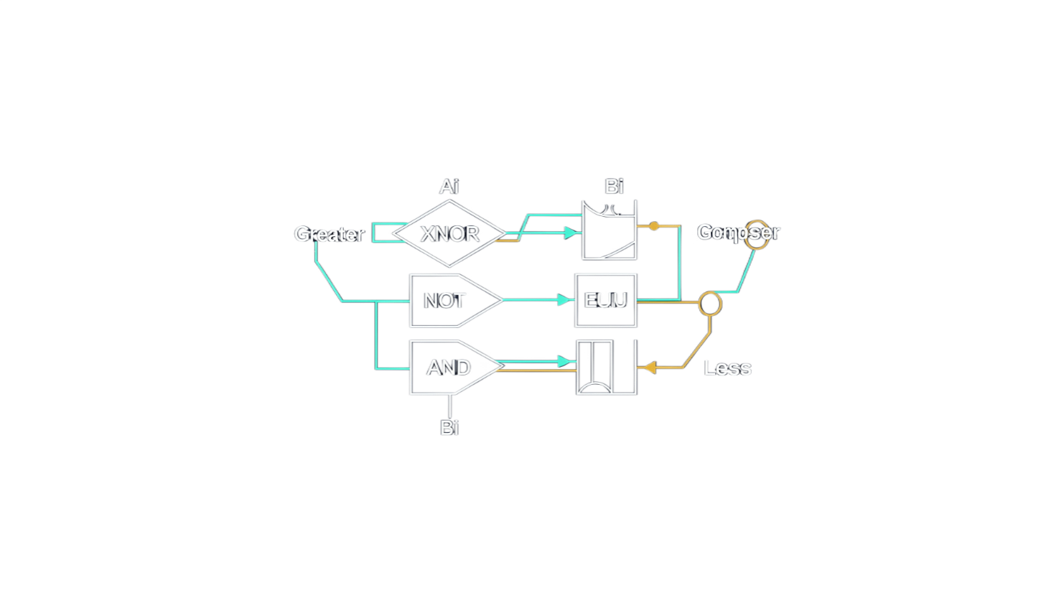
LOCAL DECISION · ONE BIT PAIR
Each bit pair produces three local results
Ai | Bi | Local result | Meaning
0 | 0 | Equal | Ai XNOR Bi
0 | 1 | Less | ¬Ai · Bi
1 | 0 | Greater | Ai · ¬Bi
1 | 1 | Equal | Ai XNOR Bi
THREE FLAGS
Greater
Equal
Less
Every bit pair produces local evidence. Higher-order pairs receive priority over lower-order pairs.
Notes:
Read the truth table row by row. The equal result appears for 00 and 11, while 10 means greater and 01 means less. These are local results; the full comparator still has to apply priority across bit positions.

Slide 4

EQUALITY PATH
Equality checks all four bit pairs
Equality is high only when every corresponding pair matches.
XNOR → E3
A>B
from MSB priority
A3 · B3
XNOR → E2
4-input AND
E3 · E2 · E1 · E0
Priority cascade
Greater and less flags from each pair feed A>B and A<B, most significant bit first.
A2 · B2
A=B
all pairs match
XNOR → E1
A1 · B1
XNOR → E0
A0 · B0
A<B
from MSB priority
Notes:
Equality is the simplest full-word output. Each XNOR gate asks whether one pair matches. The AND gate allows equality through only when all four answers are yes.

Slide 5



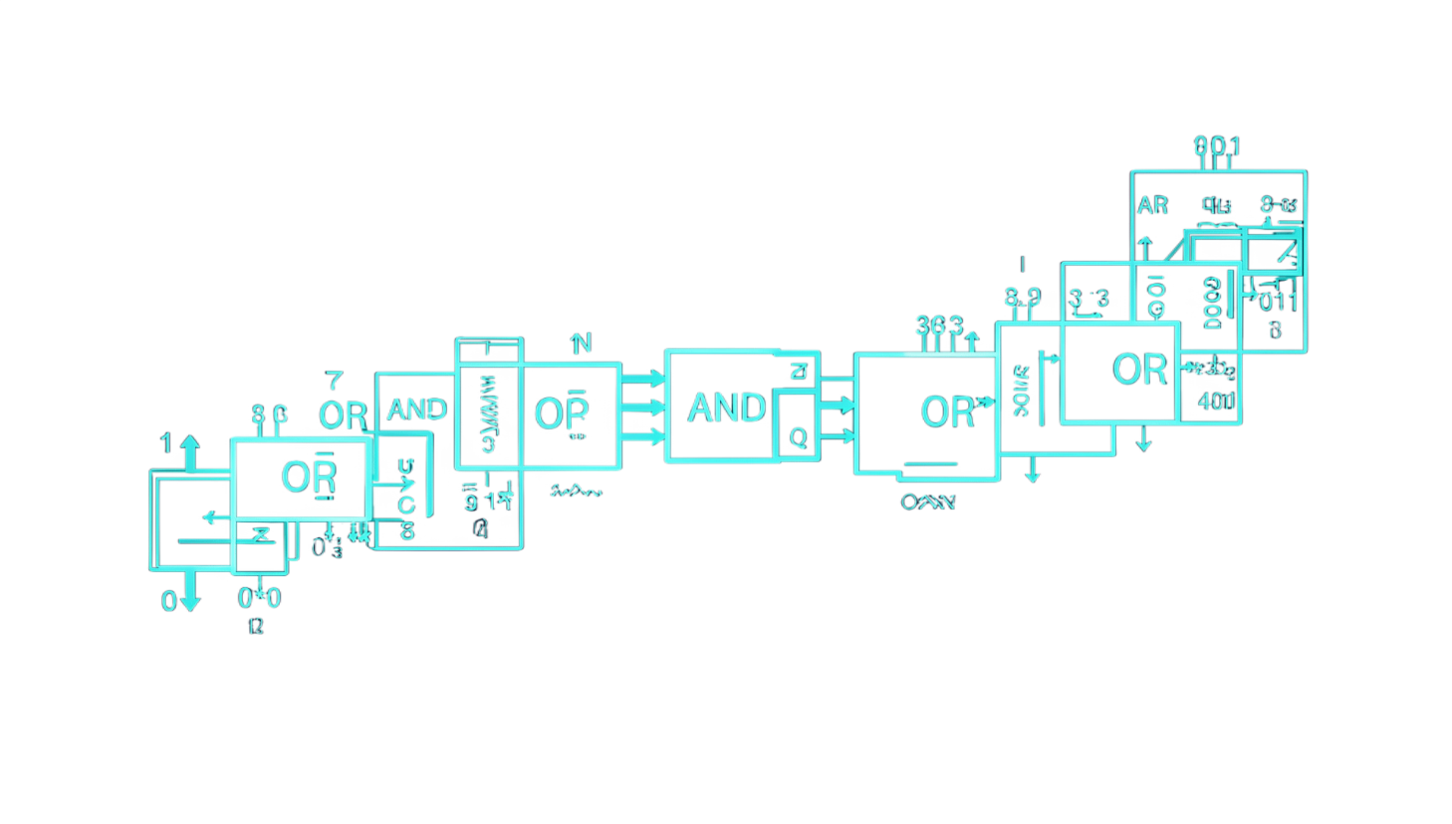
PRIORITY LOGIC
Greater-than and less-than logic cascade
GREATER
01
02
03
Compare A3, B3
Enable bit 2
Continue right
Only when E3=1.
LESS
If unequal, stop.
Match gates open the next pair.
Each lower-order term is gated by equality above it. A lower bit cannot overturn an earlier difference.
Notes:
Point out the repeated equality terms. E3 enables the bit-2 decision, E3E2 enables bit 1, and so on. That is the cascade: lower bits speak only when all higher bits have tied.

Slide 6
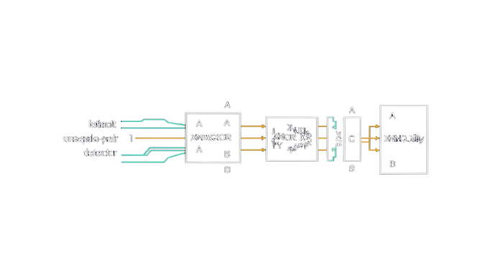
WORKED COMPARISONS
How one comparison resolves
GREATER-THAN CASE
EQUALITY CASE
1010
1101
A = 1010
B = 0110
A = 1101
B = 1101
A3=1 and B3=0. The first pair differs, so A>B is high immediately.
All four pairs match, so A=B is high. A>B and A<B stay low.
The leftmost unequal pair determines the result. Once it speaks, the remaining bits are irrelevant.
Notes:
Use the first example to make priority concrete. Although the lower three bits contain information, none of it can reverse the decision made by the most significant pair. The second example shows the only route to equality: every pair must match.

Slide 7
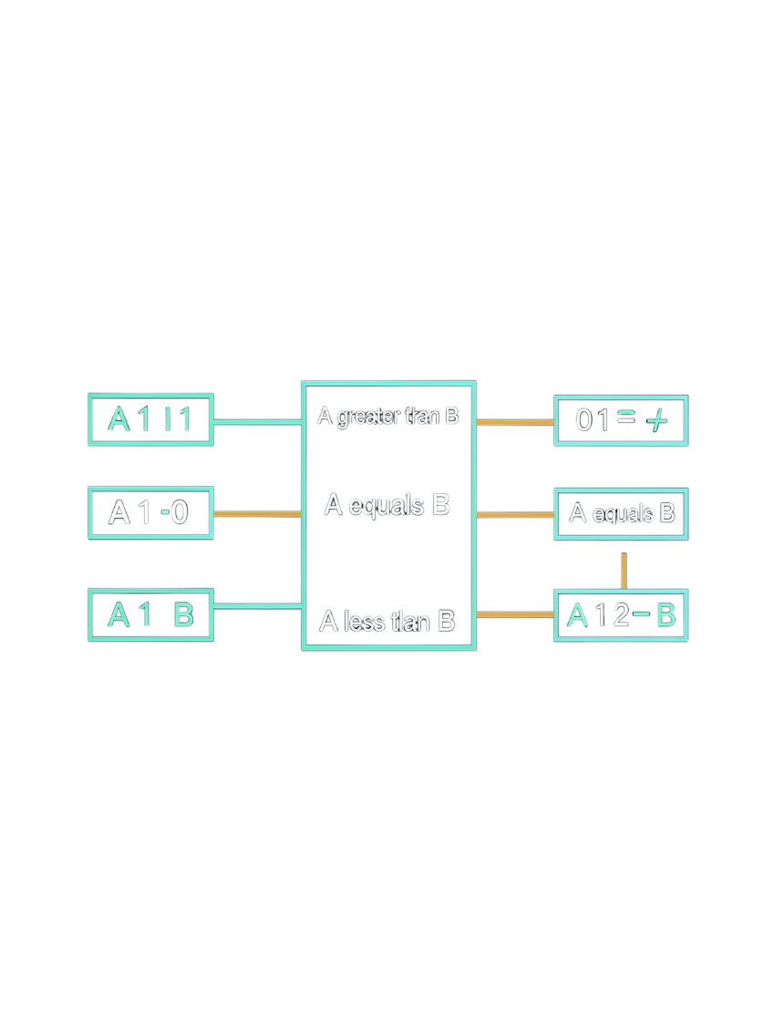




FROM FLAGS TO ACTIONS
Where magnitude comparators are used
Three mutually exclusive outputs become control decisions elsewhere in a digital system.
 | Signal → decision | Application
 | A>B → Branch | CPU and ALU condition flags
 | A=B → Enable | Address-range and limit checking
 | A<B → Alarm | Digital control systems and counters
 | Select | Sorting, selection, and priority circuits
The comparator does not make the final system decision. It supplies a clean condition for the next circuit.
Notes:
Connect the abstract outputs to familiar hardware. A processor can branch on a comparison, a controller can raise an alarm when a limit is crossed, and selection logic can choose one path from several.

Slide 8
IMPLEMENTATION CHECKLIST
Conclusion
Assemble
Verify
Expand
Use XNOR, NOT, AND, and OR gates, or a comparator IC.
For every input pair—equal or unequal—exactly one output is high.
Expand to wider words by cascading comparator stages.
A 4-bit magnitude comparator reaches one clear decision by checking the most significant unequal bit first, so the whole result follows from a single priority rule. That speed and reliability make comparators essential wherever digital systems must rank, sort, or compare values quickly.
Notes:
Close by returning to the one rule that makes the entire circuit understandable. Build the local gates, test the three outputs, and then reuse the same priority idea to scale from four bits to wider words.

Slide 9
